Slide 1
Requirements Management with Use Cases
Module 9
Requirements Across the Product Lifecycle

Slide 2
Course Outline
0 - About This Course
1 - Best Practices of Software Engineering
2 - Introduction to RMUC
3 - Analyzing the Problem
4 - Understanding Stakeholder Needs
5 - Defining the System
6 - Managing the Scope of the System
7 - Refining the System Definition
8 - Managing Changing Requirements
9 - Requirements Across the Product Lifecycle

Slide 3
Requirements Across the Product Lifecycle
Problem
Problem Space
Needs
Solution Space
Features
Traceability
The Product To Be Built
Software
Requirements
Test Procedures
Design
User Docs
Notes:
In this module we will look at how requirements evolve across the product lifecycle.
The iterative process allows us to refine the model in smaller increments at each iteration, and also helps us maintain control of the changes in requirements and use needs throughout the product lifecycle.
Use this slide to explain where we are in the class:
In this module we will look at how requirements evolve across the product lifecycle.

Slide 4
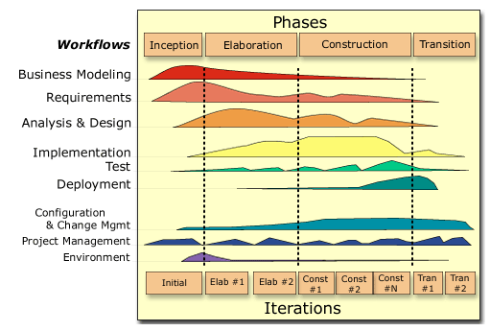
Requirements Across the Product Lifecycle
Requirements
Notes:
The nature of the work performed in the iterations varies greatly across the lifecycle. Early iterations focus on requirements capture and architectural design; in Construction, iterations tend to focus on Design, Implementation, and Test.
Also, the way you perform requirements capture within an iteration may vary depending on where you are in the lifecycle.

Slide 5
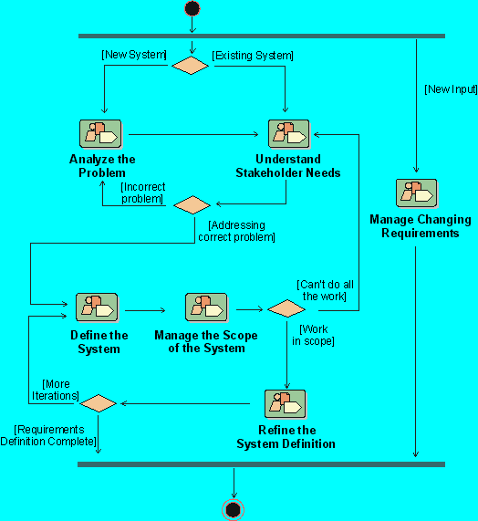
Each Iteration Makes a Pass Through Requirements
Notes:
Each iteration in Rational Unified Process involves one pass through the activities in each of the core workflows, including Requirements.
We will look at the typical state of our requirements at the end of each of the phases of our iterative process.
Where is this done in your own software development process?
If presenting this course on-site at a company not using RUP, discuss the activities they use to accomplish this objective.

Slide 6
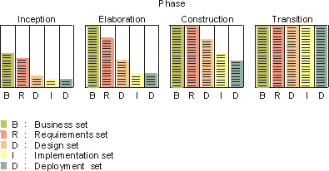
Inception Iterations: Typical Requirements Results
Collect information to develop the business case:
  A draft of a survey of the use-case model
  An initial terminology
  A few use-case flow of events (requirements capture)
  Sketches of user interfaces
  A prototype (optional)
Notes:
The purpose of the Inception phase is to establish the business case for the system and specify the project scope. To accomplish this, you must understand the context of the system, the external entities with which the system will interact, and the nature of that interaction at a high level.
In the Inception phase, the goal of an iteration is to gather enough information to develop the business case. For an initial development cycle, this may also include the development of some prototype.

Slide 7
Inception Iterations: A Pass Through Requirements
Activities
1 2 3
time
Develop Vision
Manage Dependencies
Elicit Stakeholder Needs
Capture a Common Vocabulary
Find Actors and Use Cases
Model the User Interfaces
Prioritize Use Cases
Detail a Use Case
Structure the Use-Case Model
Review the Use-Case Model
Checkpoint 1
Checkpoint 2
Checkpoint 3
Notes:
This graph illustrates how you might go about executing requirements capture activities in the Inception phase.
In this example, the team started off by conducting a “brain-storming session”, where they discussed some core concepts in their vocabulary, identified an outline of actors and use cases, and briefly described the actors and use cases.
At checkpoint 1, they had come to an agreement on the model and also selected one or two use cases to explore further.
At checkpoint 2, they defined the flow of events (a very first outline to it) of the prioritized use cases. At this checkpoint, they conducted an informal review with the project stakeholders to make sure they were on the right track and that there was business case for the project.
At checkpoint 3, they had either taken care of, or made a decision on how to take care of, all change requests.
In this example, only one preliminary iteration was performed in the inception phase. No Design, Implementation or Testing followed on the Requirements capture.

Slide 8
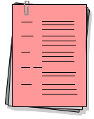
Elaboration Iterations: Typical Requirement Results
Refine requirements to build/validate architecture
  Updated terminology
  More use-case flow of events (requirements capture)
  Refinements to use cases developed in previous iterations
  Use-case view of the architecture
L
U
P
I
D
Notes:
The purpose of the Elaboration phase is to analyze the problem domain, establish a sound architectural foundation, develop the project plan, and eliminate the highest risk elements of the project. To accomplish these objectives, you must have the “mile wide and inch deep” view of the system. Architectural decisions have to be made with an understanding of the whole system: its scope, major functionality, and nonfunctional requirements, such as performance requirements.
In the Elaboration phase, the goals are to refine the requirements and to build and validate an architecture.

Slide 9
Elaboration Iterations: Pass Through Requirements
Activities
1 2 3
time
Develop Vision
Manage Dependencies
Elicit Stakeholder Needs
Capture a Common Vocabulary
Find Actors and Use Cases
Model the User Interfaces
Prioritize Use Cases
Detail a Use Case
Structure the Use-Case Model
Review the Use-Case Model
Checkpoint 1
Checkpoint 2
Checkpoint 3
Notes:
This graph illustrates how you might go about executing requirements capture activities in the Elaboration phase.
At checkpoint 1, the team defined all vocabulary that had been identified at this point and made sure they agreed on what use cases (or parts of use cases) to include in this iteration. These decisions were based on a first understanding of the architecture of the system and what use cases would be critical for that architecture.
At checkpoint 2, the flow of events for all the prioritized use cases had been written. This was completed in stages: normal flow first and then alternative flows (the ones deemed interesting from an architectural perspective). Review sessions with domain experts were performed.
At checkpoint 3, all change requests had either been taken care of or decisions had been made how to take care of them. The team also discussed and decided what use cases or parts of use cases to take into Design, Implementation, and Test.
In the next iteration of the Elaboration phase, a similar workflow was followed for requirements capture. At checkpoint 1, decisions were made on how to take care of change requests that were identified during Design, Implementation, and Test of the use-case model from the previous iteration. Use cases from the previous iteration were then updated and completed, and a new set of use cases were given flow of events descriptions. Outstanding change requests were taken care of. The use-case view of the architecture was then updated to reflect the changes.

Slide 10
Construction Iterations: Typical Requirement Results
Build the complete system. At this point, requirements should be relatively stable.
  Change requests on use-case’s flow of events
  Updated use-case flow of events
  Emphasis on analysis&design, implementation and test
Notes:
The purpose of the construction phase is to iteratively develop a complete software product that is ready for transition into the user community, starting from a baselined architecture. Thus, the remaining use cases must be completed during this phase, as well as all remaining software implementation and test.
In the construction phase, both requirements and architecture should be stable. The emphasis is on completing use-case descriptions (design) for all use cases, and on design, implementation, and test.

Slide 11
Construction Iterations: Pass Through Requirements
Activities
1 2
time
Develop Vision
Manage Dependencies
Elicit Stakeholder Needs
Capture a Common Vocabulary
Find Actors and Use Cases
Model the User Interfaces
Prioritize Use Cases
Detail a Use Case
Structure the Use-Case Model
Review the Use-Case Model
Checkpoint 1
Checkpoint 2
Notes:
In the Construction phase, the only requirements capture activities that occur are to take care of the change requests that were identified during Design, Implementation, and Test.

Slide 12
Transition Iterations: Typical Requirements Results
Normally, requirements should not change at this late stage of the project.
However, if decisions are made to add new features to the system, an iteration (and produced results) would be similar to a typical construction-phase iteration.
Notes:
The purpose of the transition phase is to transition the software product into the user community. Once the product has been given to the end user, issues usually arise that require you to develop new releases, correct some problems, or finish some of the features that may have been postponed.
Normally, requirements should not change at this late stage of the project.
In the transition phase, the activities performed during an iteration depend on the goal -- fixing bugs, implementation, and test are usually enough. Fixing bugs may involve fixing a problem discovered in the requirements. If new features have to be added, the iteration is similar to the construction phase.

Slide 13
Iteration Assessment
Assess requirements capture results relative to the evaluation criteria established during iteration planning:
  Functionality
  Performance
  Capacity
  Quality measures
Consider external changes that have occurred during this iteration
  Examples: changes to requirements, user needs, competitor’s plans
Determine what rework, if any, is required and assign it to the remaining iterations
Notes:
Each iteration is concluded by an iteration assessment where the development organization pauses and reflects on what has happened, what was achieved or not (and why), and uses the lessons learned to improve the organization and the process for future iterations.
For this iteration assessment, you assess the results of the iteration relative to the evaluation criteria that were established in the iteration plan: functionality, performance, capacity, quality measures.
This is a critical step in making the iterative approach successful. If this is not done properly, the benefits of the iterative approach will be lessened.
Also, remember that at times the right thing to do in this step is to revise the evaluation criteria rather than reworking the system. Sometimes, the benefit of the iteration is in revealing that a particular requirement is not important, or is too expensive to implement, or creates an architecture that cannot be maintained. In these cases, a cost/benefit capture must be done. This is a business decision.

Slide 14
Reviewing Requirements
Informal reviews
  To find errors
  Whenever needed
  Small team, possibly including QA
Formal reviews
  To decide whether to proceed to next phase
  At milestones and tollgates
  Large reviewing team, including customers
Notes:
All new and changed requirements (use cases) need to be reviewed by a review group.
There are both formal and informal reviews.
The main differences between formal and informal reviews are the purpose and timing of the review.
Informal reviews can be done any time you need another pair of eyes to look at what you are working on. The purpose is primarily to find errors.
Formal reviews are done at major decision points in the project. These decision points are called milestones. A “tollgate” is a milestone with financial decisions to be made. For example, at the end of the inception phase, there is a milestone in RUP called the "Lifecycle Objectives Milestone". At this point, you examine the lifecycle objectives of the project, and decide either to proceed with the project or to cancel it. The decision to fund/not fund the remainder of the project is a tollgate.

Slide 15
Types of Reviews
  Walkthrough
  Inspection
  Formal Review
Less Formal
More Formal
IEEE, 1994
Notes:
As you progress through the development lifecycle, the reviews will become more and more formal until the final formal is accepted.
IEEE defines 3 types of reviews of different levels of formality and ceremony.

Slide 16
Reviewing Requirements: Walkthrough
Purpose
  Find errors in an early stage
  Find deviations from approved style, technique, standards
  Informing
Participants
  Analyst
  1 - a few project members, need not be prepared
Procedure
  Analyst gives an overview of the results
  Analyst walks through reviewed chapters, other participants comment
  Analyst makes notes on errors found
Notes:
Walkthroughs are the least formal.
We talked about this during the elicitation techniques section when we discussed doing a walkthrough of a customer-generated spec.

Slide 17
Reviewing Requirements: Inspection
Purpose
  To get views from different parts of the organization
  To become aware of each other’s views
  To find errors and problems early
    Problems surfacing at the end may kill the project!
  To decide whether the reviewed document should be
    Approved, approved with corrections, or rejected
Participants
  Moderator
  Recorder
  Author
  Inspectors
Notes:
Inspections are more formal than walkthroughs and are used to gain information as well as to find problems or errors.

Slide 18
Who Should be Inspectors?
Users of the system
Members of departments using the new system
  Representatives of all departments using new system
  Not just those that are involved in this use case
Process owners
Managers of the users
Domain experts
Designers of the system
Notes:
The role that the different groups are playing during the inspection depends on who wrote the use case (or other requirements document).
If this was done by a specific analysis team familiar with the problem domain, then the designers are an important inspector group.
On the other hand, if the designers wrote the use cases, then it would be very important to include the inspectors from the domain expertise.

Slide 19
How to Organize an Inspection
Before the meeting - At least 1 week in advance
  Invite Inspectors (Hint: < 8)
  Distribute materials (Hint: < 50 pages)
  Have inspectors read materials and write comments
At the meeting
  Moderator leads and keeps meeting focused
    Keep the meeting short and fast (Hint: < 2 hours)
  Recorder records all issues
  Inspectors look for and discuss errors
    Objective is to find problems - not to solve them
    Spelling and typographical errors will be handled directly with the author outside the meeting
Notes:
Why is it important that the inspectors write their comments ahead of time?
Why is it important that the inspectors have written their comments?
It is the only way for the moderator to see if they have done their homework!
Too often it happens that some inspector has not read the paper and tries to read it during the inspection meeting. That attitude does not work - to inspect something you have to read it in advance and decide the issues to discuss.

Slide 20
Instructions for Inspectors
Inspectors need instructions. A brief example:
For the use-case model
  Do you understand what this system will look like?
  Is it worth the money to build it?
For each use case or other requirement
  Do you understand how to do this kind of work with the new system?
  Is this a good way to do it?
  Is something missing?
  Is there a better way to do it?
Notes:
When sending out use cases to your users, you will want to include some kind of inspectors’ instruction. Here are some ideas to include.

Slide 21
Results of an Inspection
Major Problems
  Severe problem: a section has to be reworked
  Use case can’t be approved: a new inspection is required
Minor Problems
  Things that can be fixed
  Approval of use case may be delegated to moderator
Recommendations
  Give concrete, constructive suggestions for improvements
  Avoid too general comments like “bad” or “unclear”
  Do not focus only on the negative, note positives too
Notes:
Minor remarks do not usually require a new inspection. It is normal that minor corrections be approved by the moderator, etc.

Slide 22
Reviewing Requirements: Formal Review
Purpose
  To ensure that results are complete and consistent
  To decide on continuation of project
Participants
  Top management, project leaders, process owners, analysts
Procedure
  Check status of documents (evaluation results)
  Review outcome of the project
  Authorize start of next phase
Notes:
This is the most formal type of review.
This is usually done at formal checkpoints during the project, and at the final review and acceptance point for a release to the customer.

Slide 23
Exercise: Review the Use-Case Model
Review the current state of the use-case model of one of the groups in the class
  What type of review would be appropriate at this point in time?
Notes:
RECOMMENDED:
Whole-class or group exercise.
Estimated time: 5-30 minutes.
Probably, this exercise will be skipped due to time constraints.
You can refer back to the reviews that we have been doing at the end of each of the previous exercises.
Might just want to have a discussion on the type of review that would be done at the early stages of the project (such as where we are now with our class project)
Probably a walkthrough is most appropriate, especially since we do not have a formal set of requirements against which to compare our current model.

Slide 24
Review: Requirements Across the Product Lifecycle
1. What is the typical state of a use-case model at end of
  The Inception phase?
  The Elaboration phase?
  The Construction phase?
  The Transition phase?
2. Under what circumstances would you change anything in the use-case model during the Transition phase?
3. What is the purpose and contents of an iteration assessment?
4. What are the different types of reviews? When might each be used?
Notes:
Use these questions to monitor the students’ level of understanding and to help them review.
Tell them they can look back through the material to get the answers.
Give them time to answer. Don’t be afraid to stand quietly while they look up the answer.

Slide 25
RMUC: Summary
Build the right system right by following a process to define and manage requirements to meet the customer’s real needs
Effective problem analysis will help avoid the “Yes, but…”
Elicitation helps you understand your stakeholders’ needs
Use features and a use-case model to come to an agreement with the customer on the definition of the system
Increase your chances to deliver on time and on budget by managing scope throughout the lifecycle of the project
A use-case model of the software requirements helps refine the system definition to drive design, test, and user documentation
Requirement attributes and traceability help you manage change and avoid “scope creep”
Notes:
Summarize each of the key skills that we emphasized throughout the course.

Slide 26
Applying RMUC Concepts: Handouts
Summary: Key Skills for Requirements Management
White Paper: Applying Requirements Management with Use Cases
Handout
Notes:
Point out the white paper Key Skills for RM at the end of the Student Handouts.
It is a very useful summary sheet to help them keep track of where they are in their process and to make sure they are covering all the items.
The white paper Applying Requirements Management with Use Cases in the Student Handouts contains additional helpful information.

Slide 27
Why Are We Here?
The GOAL is to deliver quality products
on time and on budget
which meet the customer’s real needs.
Notes:
What did we learn that might help us meet this goal?
Go back to the student need elicited during the first exercise (should have these posted on the wall somewhere).
Go through each one and ask, “How many of you wanted this?” “What did you learn that might apply to meeting this need?”

